Slide 1


AGE 316
MICROCOMPUTER SYSTEMS
LECTURE 6: ANALOG I/O & PWM
Dr. Kadeghe Fue
Department of Agricultural Engineering

Slide 2



Recap: Lecture 5
Variables: Storing data (int, float, bool).
Control Flow: Making decisions with if/else.
Digital I/O: We mastered turning things fully ON or fully OFF.
Question:

Slide 3

The Real World is Analog
Digital World
Analog World
Discrete steps. Only two states.
Continuous range of values.
•
ON or OFF
•
Temperature (24.5°C)
•
5V or 0V
•
Sound Volume
•
High or Low
•
Light Intensity

Slide 4


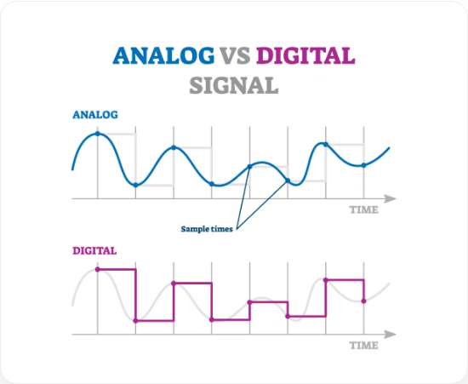



Visualizing Signals
Digital
Square Wave. Sharp transitions.
Analog
Sine Wave. Smooth, flowing changes.

Slide 5


Arduino Analog Inputs
Pins A0 to A5
The Arduino Uno has 6 dedicated pins for reading analog signals.
Function: Measure voltage between 0V and 5V.
[ A0 | A1 | A2 | A3 | A4 | A5 ]
Analog In Header
ADC: Connected internally to the Analog to Digital Converter.

Slide 6

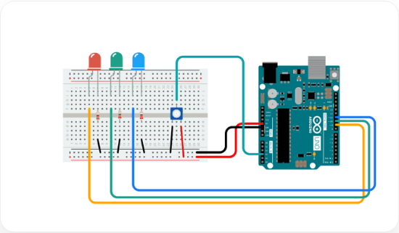
The Potentiometer (Pot)
Variable Resistor
A knob that changes voltage output based on rotation.
Wiring:
1.
Pin 1: 5V (VCC)
2.
Pin 2 (Middle): Arduino Analog Pin (e.g., A0)
3.
Pin 3: Ground (GND)
Turning the knob varies the middle pin voltage from 0V to 5V.

Slide 7



The ADC (Analog to Digital Converter)
Microcontrollers are digital (1s and 0s). They can't directly "understand" 2.5 Volts.
The ADC translates voltage into a number.
10-bit Resolution
The Range
The Arduino Uno uses a 10-bit ADC.
0V → 0
2¹⁰ = 1024 steps.
5V → 1023

Slide 8

ADC Math Visualization
Mapping Voltage to Integers:
0V
2.5V
5V
0
512
1023

Slide 9

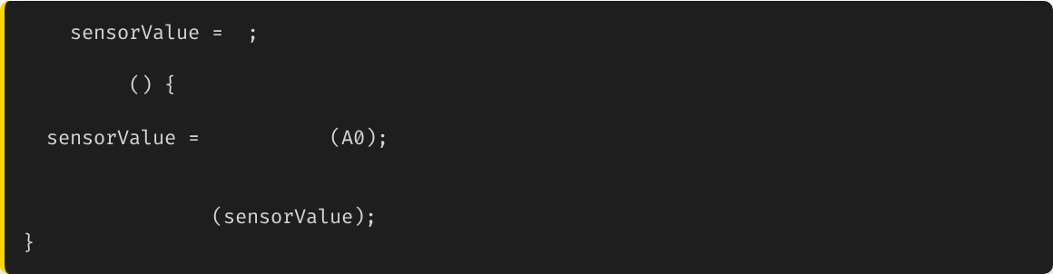

Code: analogRead()
Reads the value from the specified analog pin.
int
0
void
loop
// Read pin A0
analogRead
// Print to Serial Monitor (0-1023)
Serial.println

Slide 10



The Output Problem
We can Read, but can we Write?
Digital pins can only output 5V or 0V.
How do we dim an LED or run a motor at half speed (2.5V)?
We need a trick.
Fact:

Slide 11

The Trick: PWM
Pulse Width Modulation
PWM fakes an analog output by turning a digital pin ON and OFF very, very fast.
•
If it's ON 50% of the time, the average voltage is 2.5V.
•
If it's ON 10% of the time, the average voltage is 0.5V.
•
Your eye (or a motor) averages this out, seeing a "dim" light.

Slide 12


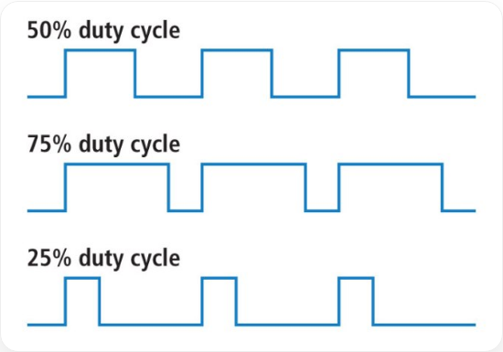


Visualizing Duty Cycle
0% Duty Cycle
Always Off (0V)
50% Duty Cycle
Half On/Half Off (~2.5V)
100% Duty Cycle
Always On (5V)

Slide 13


Code: analogWrite()
Writes an analog value (PWM wave) to a pin.
Only works on pins marked with ~ (3, 5, 6, 9, 10, 11).
void
loop
// 0 (always off) to 255 (always on)
analogWrite
9
127
// ~50% brightness
delay
1000
analogWrite
9
255
// Full brightness

Slide 14





Important: Input vs Output Resolution
Input (Read)
Output (Write)
10-bit Resolution
8-bit Resolution
0 - 1023
0 - 255
You CANNOT directly write an input value to an output pin without math!

Slide 15

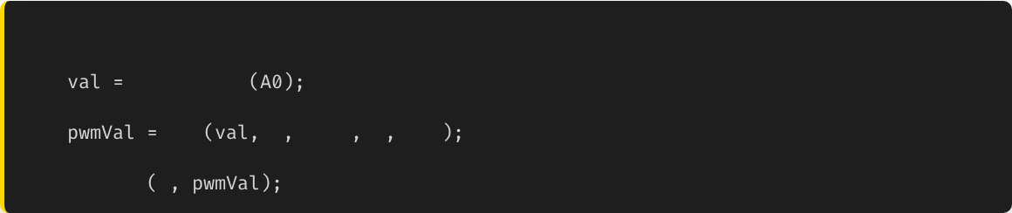
The Solution: map()
Re-maps a number from one range to another.
// Syntax: map(value, fromLow, fromHigh, toLow, toHigh)
int
analogRead
// Reads 0-1023
int
map
0
1023
255
0
analogWrite
9

Slide 16

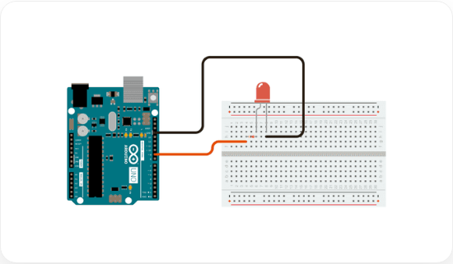
Project: Fading LED
The "Breathing" Effect
Instead of blinking, we slowly increase and decrease brightness.
Goal: Use a `for` loop to increment `analogWrite` from 0 to 255, then decrement back to 0.

Slide 17






Summary
Input (ADC)
Output (PWM)
Mapping
Reads 0-5V as integers 0-1023. Used for sensors.
Simulates analog voltage. Range 0-255. Used for dimming/motors.
Use map() to convert between input and output ranges.

Slide 18


Questions?
"The only stupid question is the one you don't ask."
Dr. Kadeghe Fue
Sokoine University of Agriculture

Slide 19





Image Sources
https://crossroadenergy.com/wp-content/uploads/2024/02/Digital-Vs-Analgo.jpg
Source: crossroadenergy.com
https://docs.arduino.cc/static/cd251a1c1ed8b6a98a0785e55608cac0/a6d36/potentiometer-circuit.png
Source: arduino.cc
https://cdn.sparkfun.com/assets/f/9/c/8/a/512e869bce395fbc64000002.JPG
Source: learn.sparkfun.com
https://docs.arduino.cc/static/d64f7f76fc5ba2668a1684d1d7583207/a6d36/simplefade_bb.png
Source: www.arduino.cc

